Slide 1

The Principles of Design and Their Importance

Slide 2
Bawantha Thilan
Year 3 semester 2
BSc Special (Hons) Degree in IT specializing Information Technology.
Sewvandi Wickramasinghe
Year 3 semester 2
BSc Special (Hons) Degree in IT specializing Software Engineering

Slide 3

Contents
01
Contrast
02
Balance
03
White Space
04
Proportion
05
Patterns

Slide 4
Contents
06
Repetition
07
Hierarchy
08
Movement
09
Variety
10
Unity

Slide 5
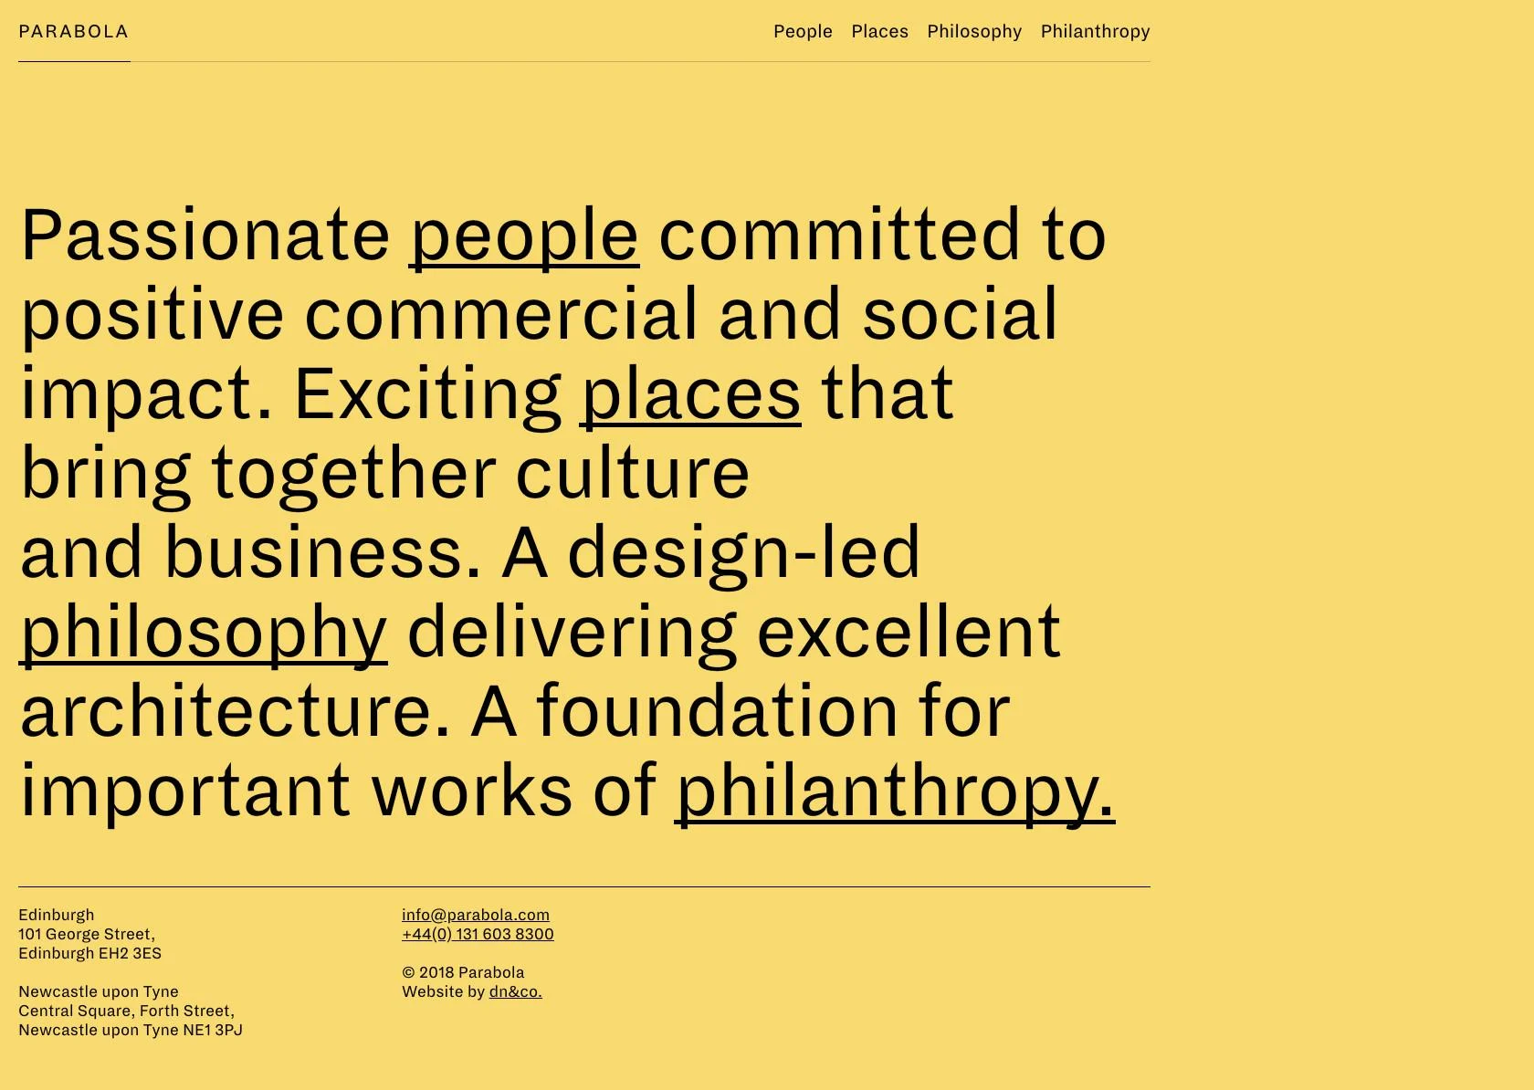
Contrast
Parabola’s website is an excellent example of a high-contrast design.

Slide 6

Balance
A slightly off-centered layout lends balance between the bold image and minimalist typography on The Nue Co’s website.

Slide 7
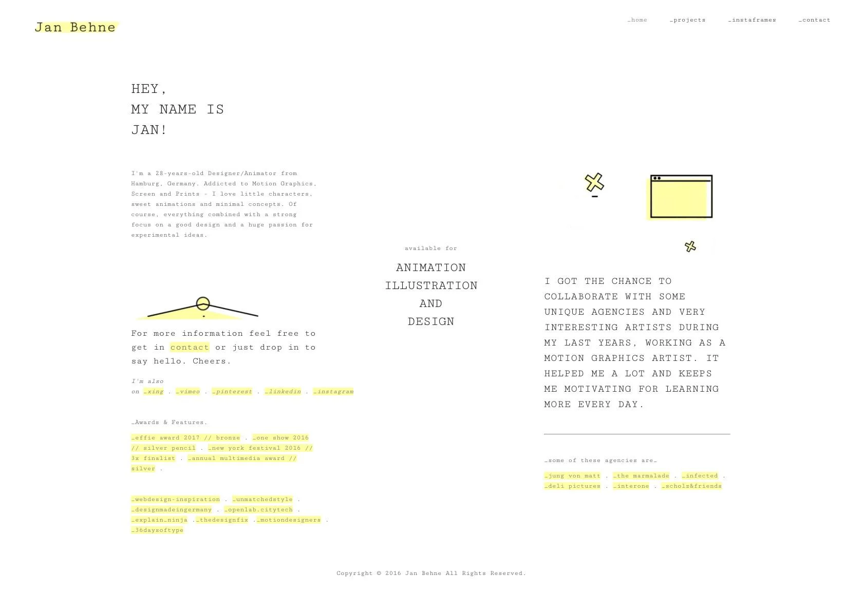
White Space
White space gives the simple text and illustrated content of Jan Behne’s website room to “breathe” while contributing to a minimalist aesthetic.

Slide 8
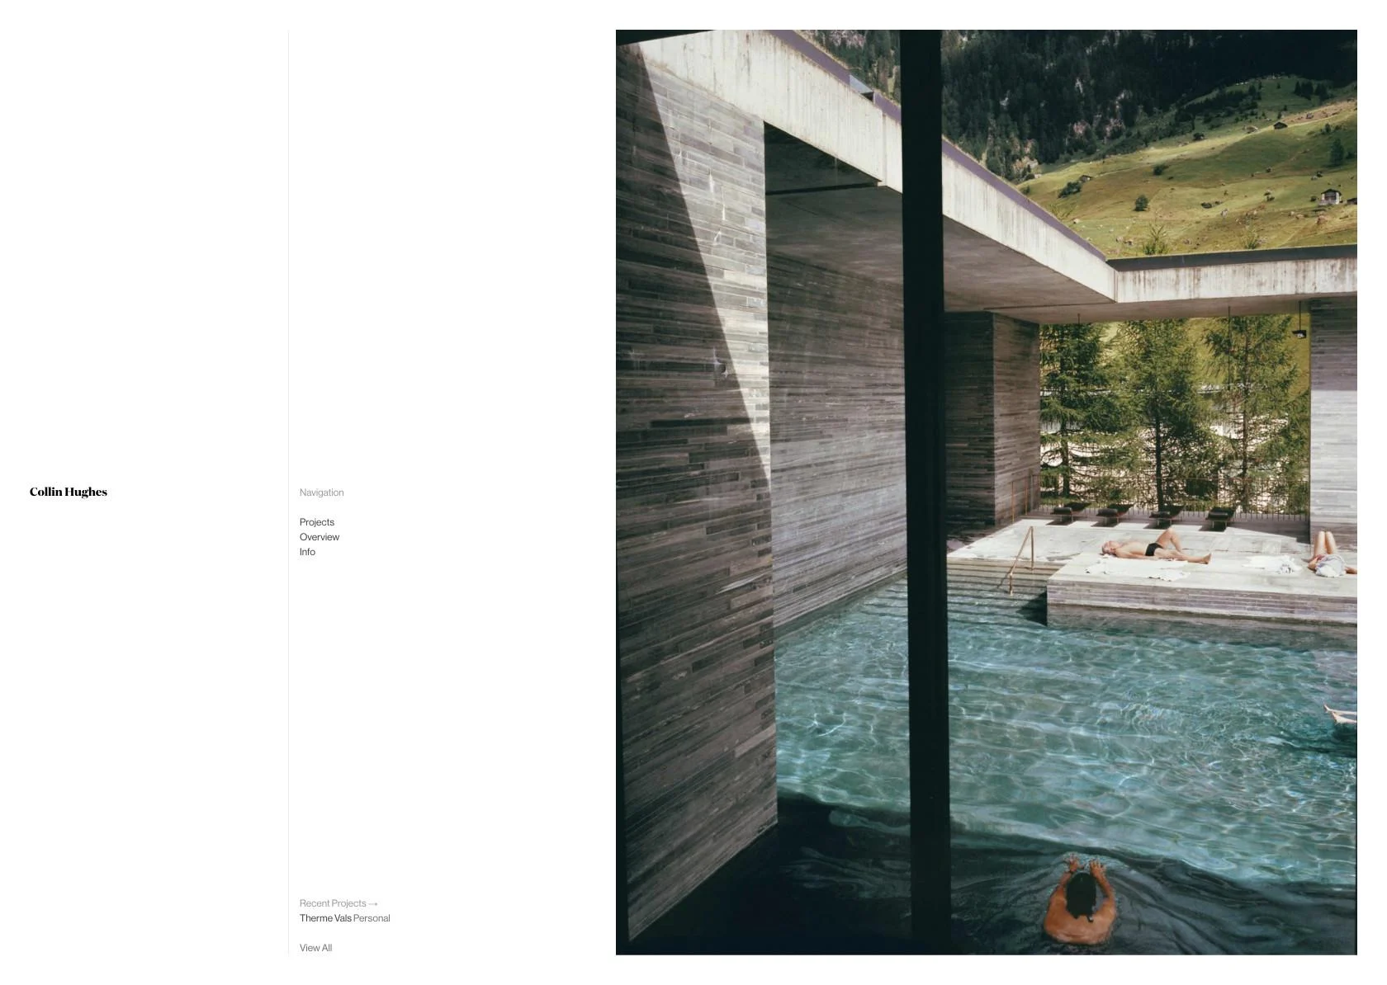
Proportion
The proportional differences between the tiny type and large images clearly delineates which elements are the most important on Collin Hughes’ website.

Slide 9
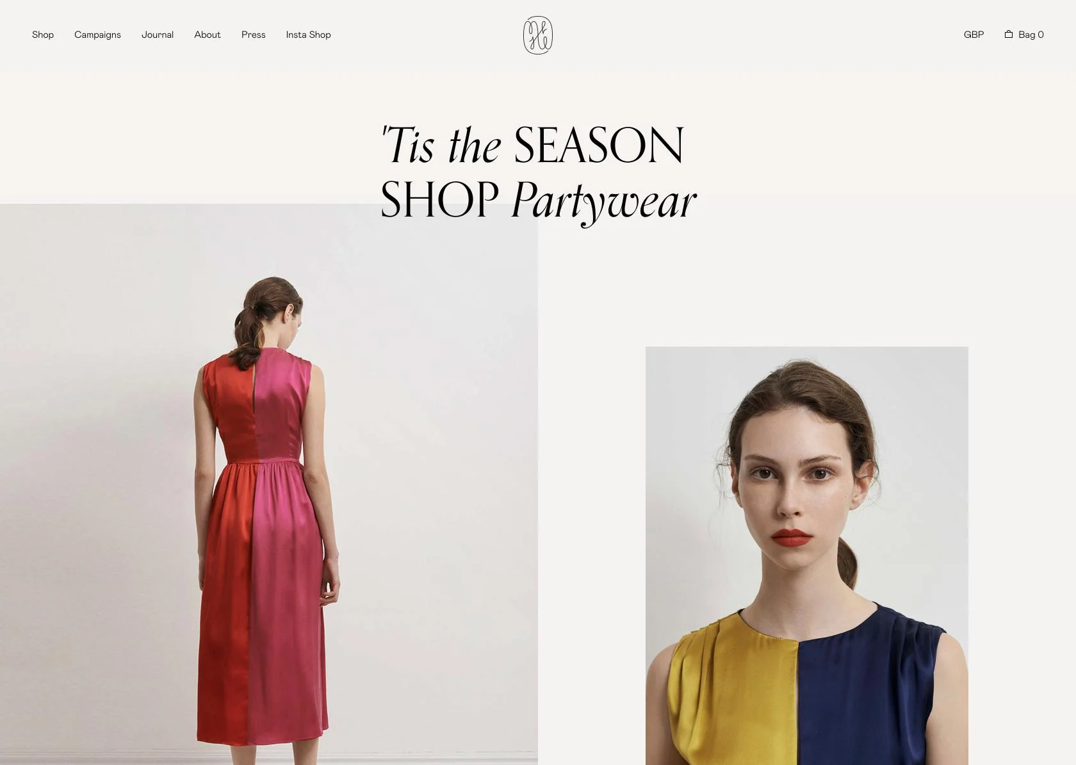
Pattern
Top navigation is one of the most ubiquitous design patterns on the internet, illustrated here on Isabelle Fox’s website.

Slide 10
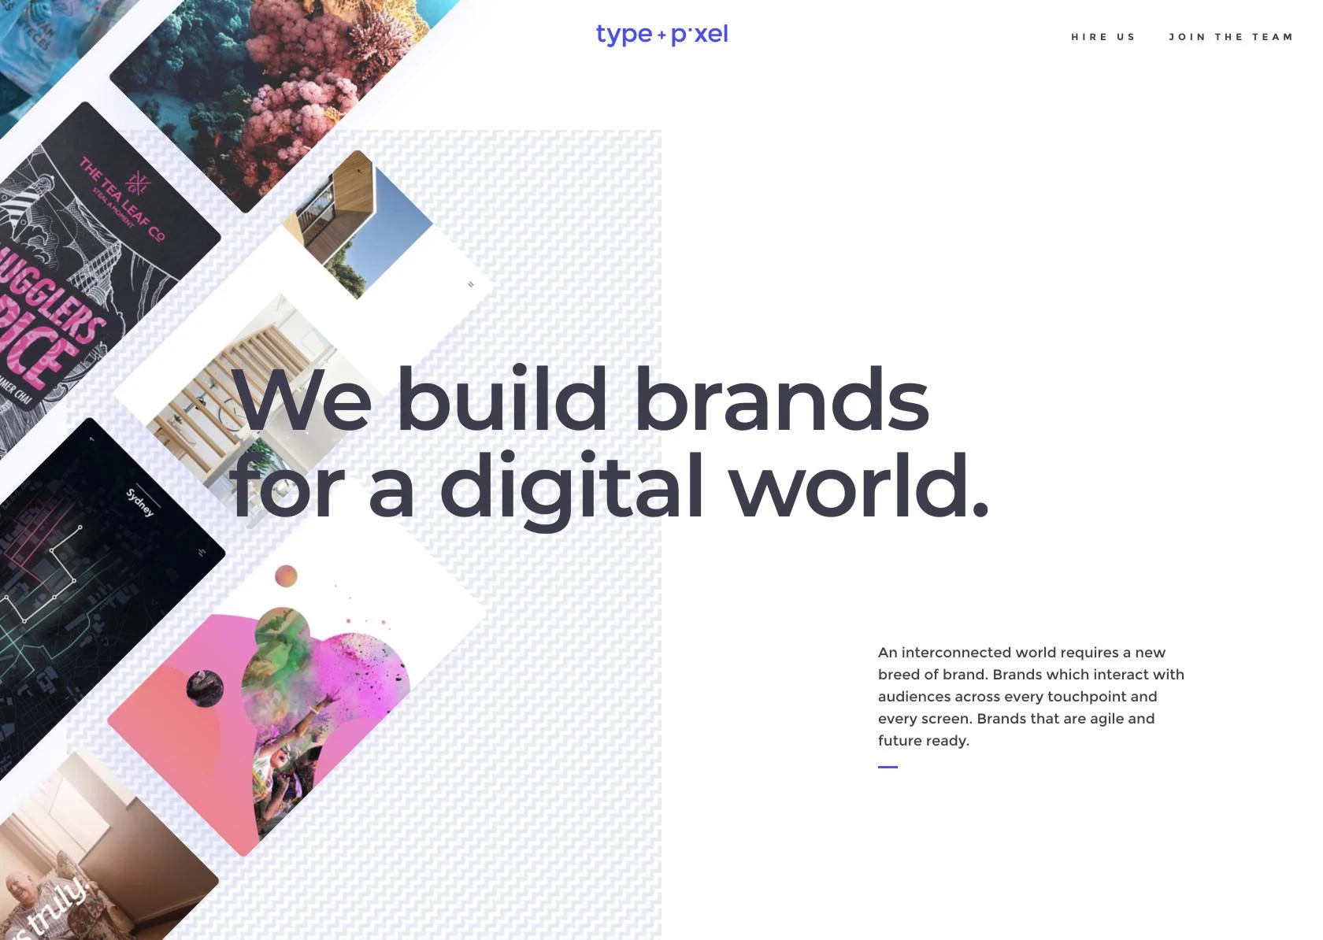
Repetition
The images on the left-hand side of Type and Pixel’s website are a great example of repetition in design.

Slide 11
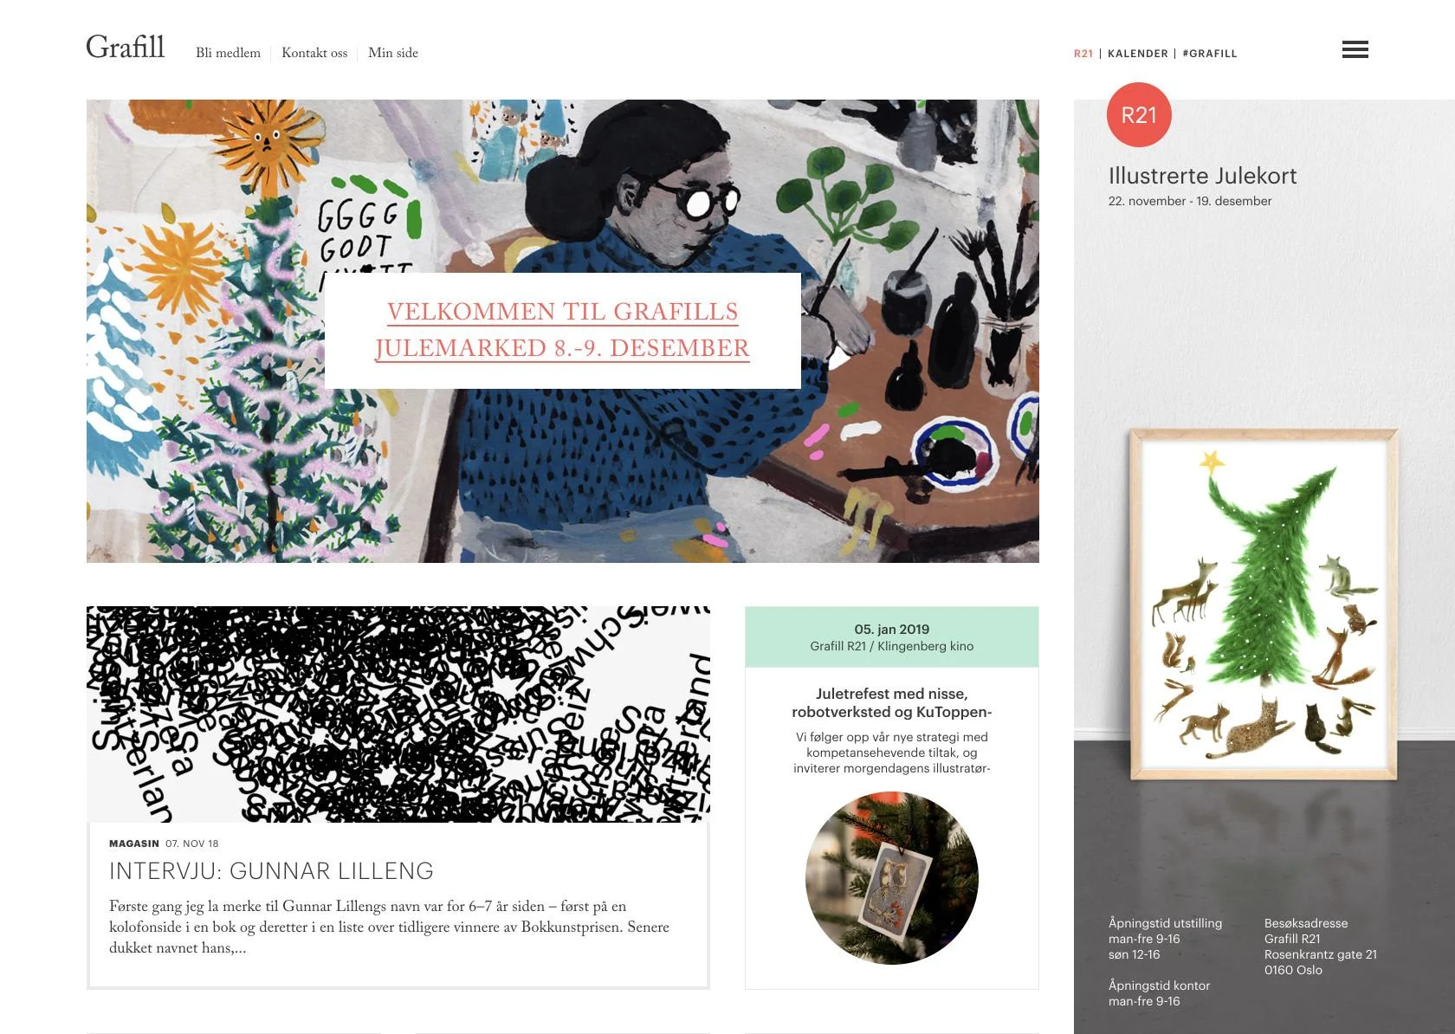
Hierarchy
Grafill’s website creates hierarchy through the use of layout (the most important part is at the top), size (more important content is larger), and typography (headlines are larger than body text).

Slide 12
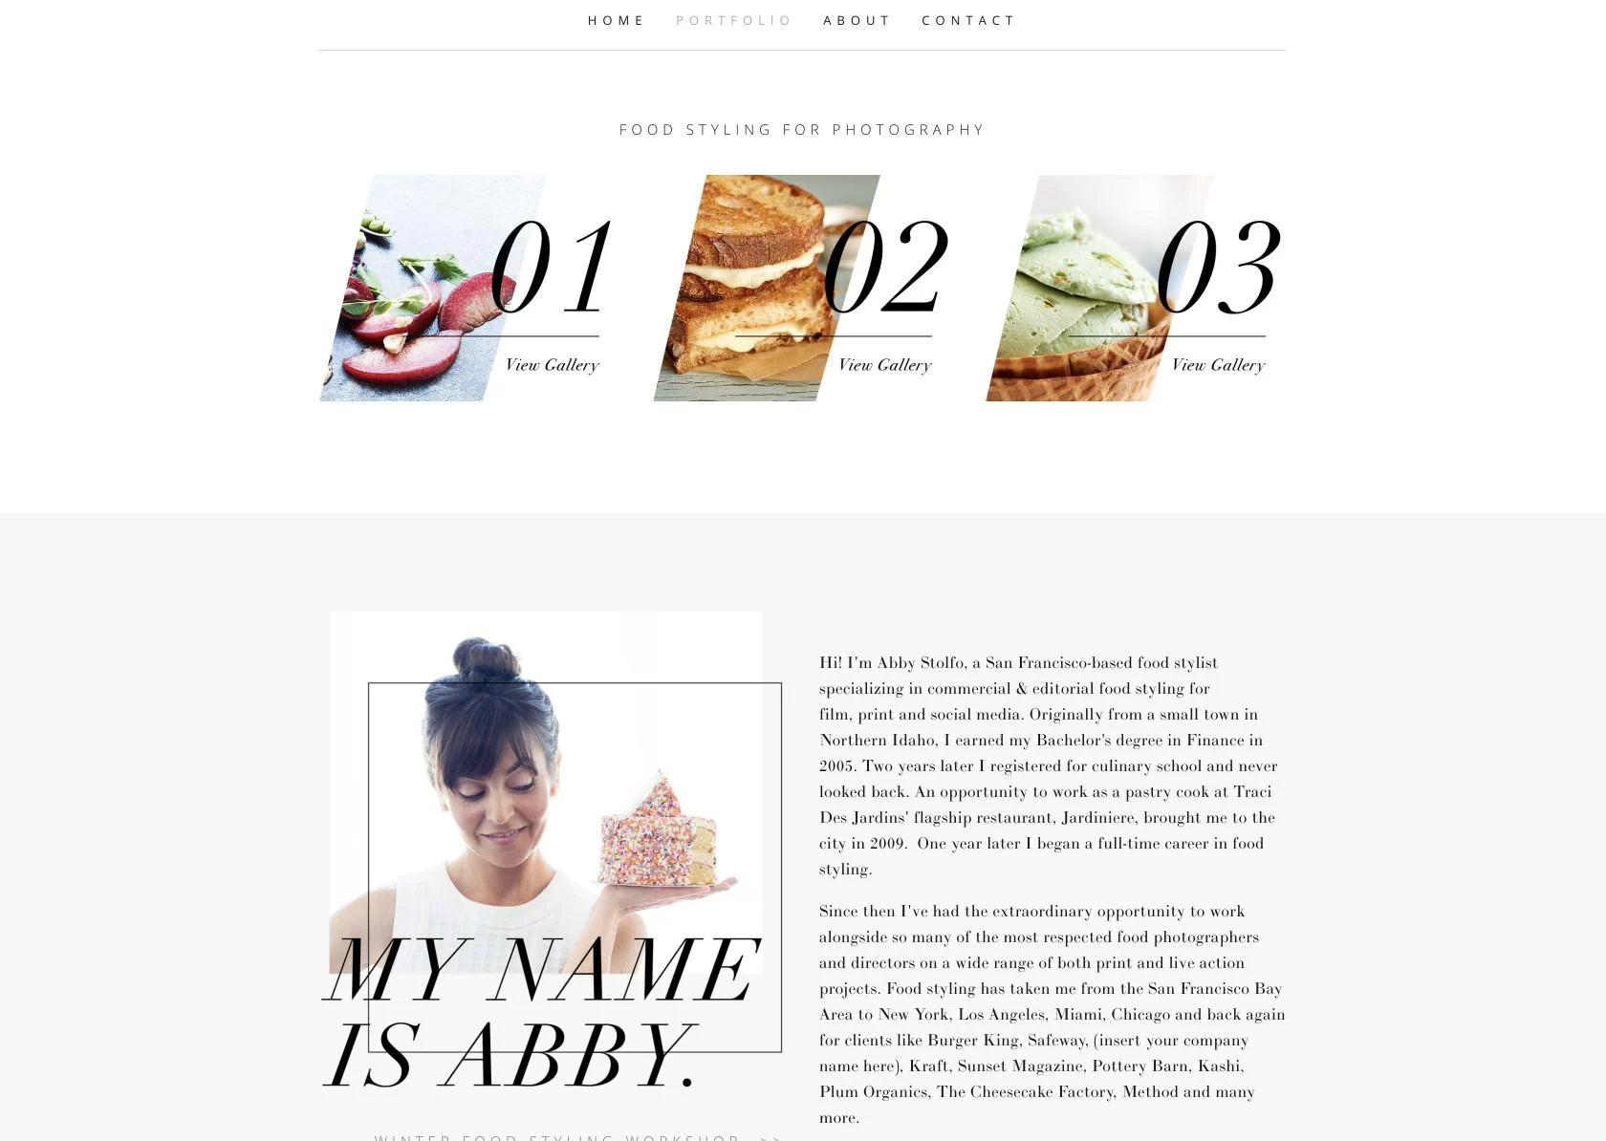
Movement
The slanted images and numbers contribute to the movement principle on Abby Stolfo’s website.

Slide 13

Verity
Kennard Lilly’s website background uses a variety of colors and shapes to create interest, while also placing emphasis on the primary text content.

Slide 14
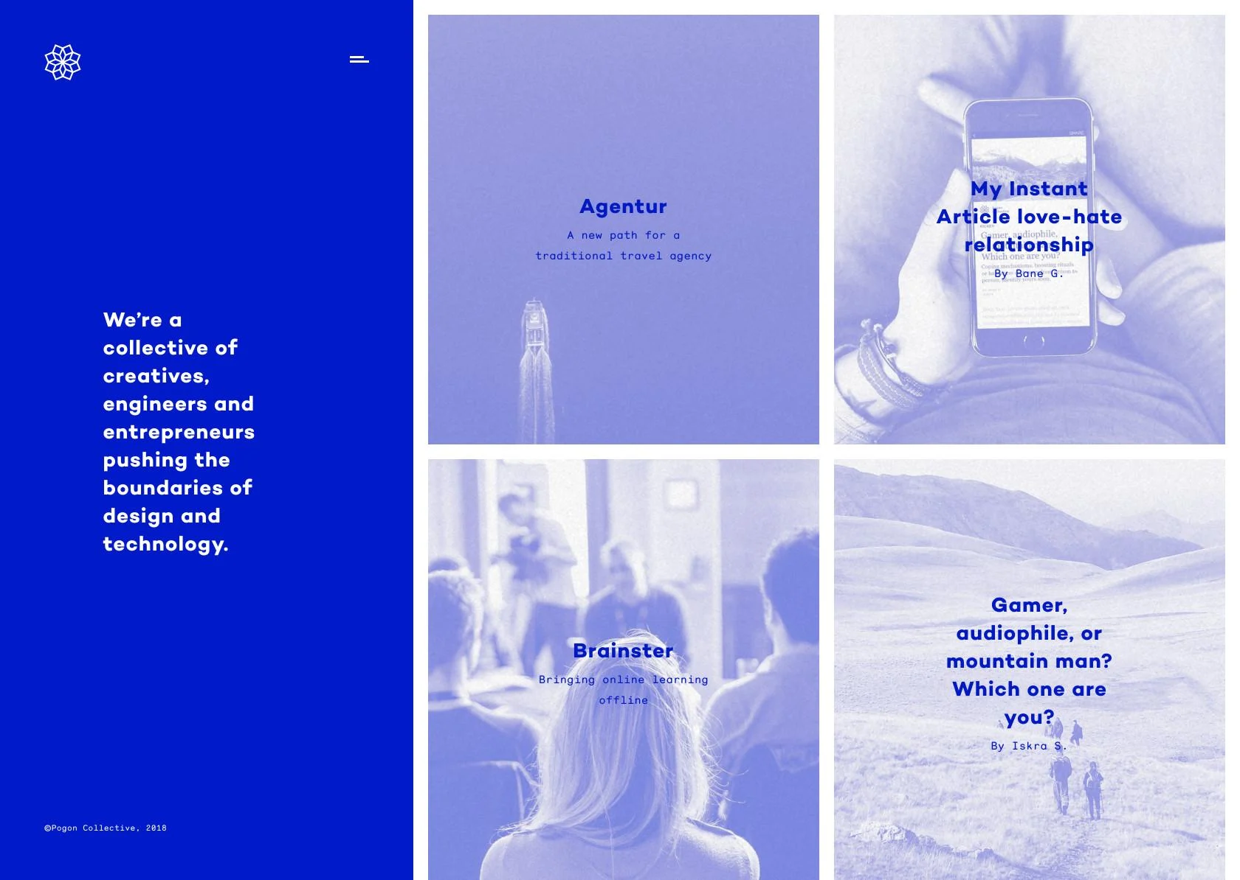
Unity
The use of a blue throughout the design (including the blue overlays on the images), along with consistent typography and proportion, creates a sense of unity in the design.

Slide 15
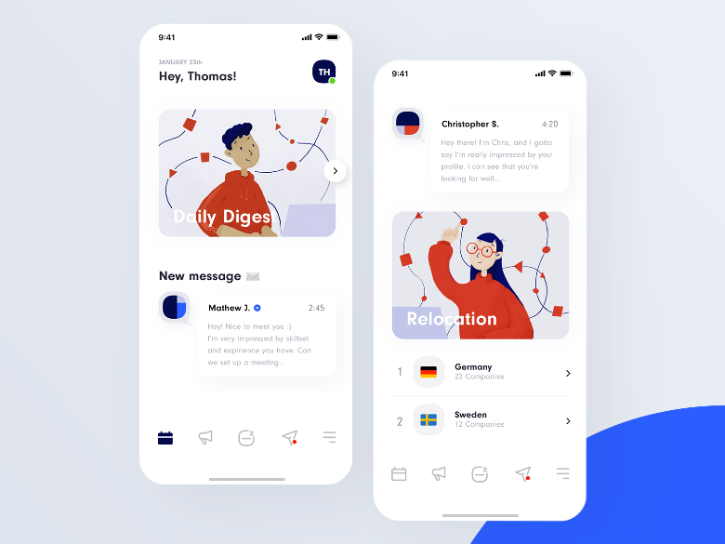
Conclusion
Designers should aim to understand how each of these design principles actually impact their work.
Designers could save a lot of time and energy by practicing the principle
Designers could study how other designers have implemented these ideas to structure their own design

Slide 16
Thank you

